Slide 1
Diwali Sales Project
By:- Rituraj Sharma

Slide 2
Understand Customer Behavior: Analyze the dataset to identify key customer segments based on demographics like gender, age, location, and marital status. Identify Sales Trends: Examine sales data to understand the top-selling product categories and regions during Diwali. Optimize Marketing Strategies: Develop targeted marketing campaigns based on the identified customer segments and sales trends. Improve Product Offerings: Identify potential gaps in product offerings and explore new product categories based on customer demand. Maximize Sales and Revenue: Leverage the insights from the analysis to maximize sales and revenue during Diwali.
Agenda

Slide 3
Steps done
01
01
02
03
04
Step – A
Step - B
Data Collection
Data cleaning and preprocessing
Step - C
Step - D
Data visualization and insights
Conclusion

Slide 4
Key Questions
How Many Sales according to the gender
Purchasing by age group
Total Amount with age group
Total number of purchasing by top 10 states
Total number of purchasing by top 10 states with amount
Purchasing by Marital Status
Category of the purchasing product
Top 10 Sales purchase id

Slide 5
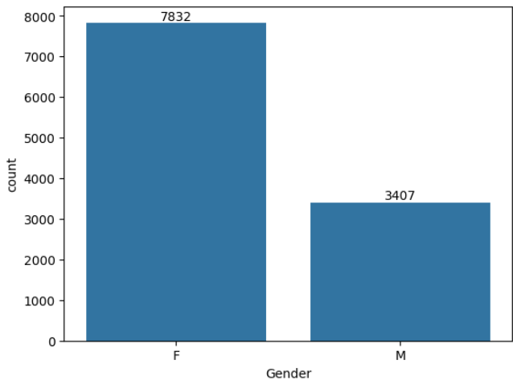
Q.1 How Many Sales according to the gender
Females are the primary buyers, with significantly higher sales compared to males, suggesting a greater purchasing power and inclination towards festive shopping among women.

Slide 6
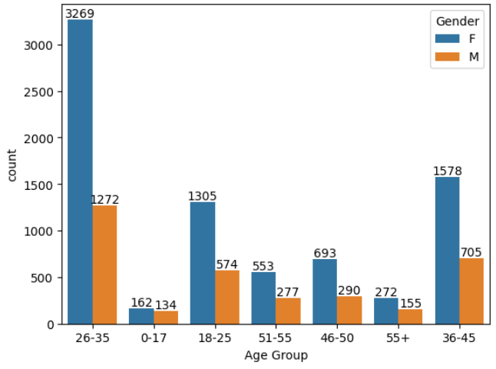
Q.2 Purchasing by age group
The age group of 26-35 years is the most active during Diwali sales, indicating that this demographic is a key target audience for festive promotions.

Slide 7
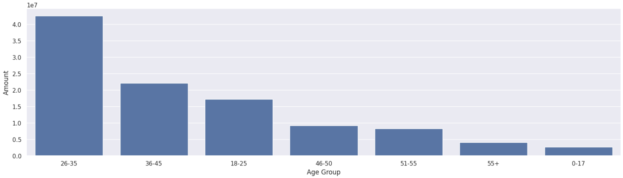
Q.3 Total Amount with age group
The 26-35 age group contributes the highest sales revenue, reinforcing their importance as a valuable customer segment.

Slide 8
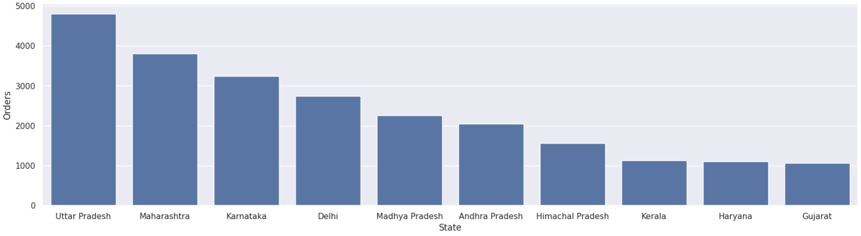
Q.4Total number of purchasing by top 10 states
Uttar Pradesh, Maharashtra, and Karnataka are the top states with the highest number of orders, indicating higher demand and market potential in these regions.

Slide 9
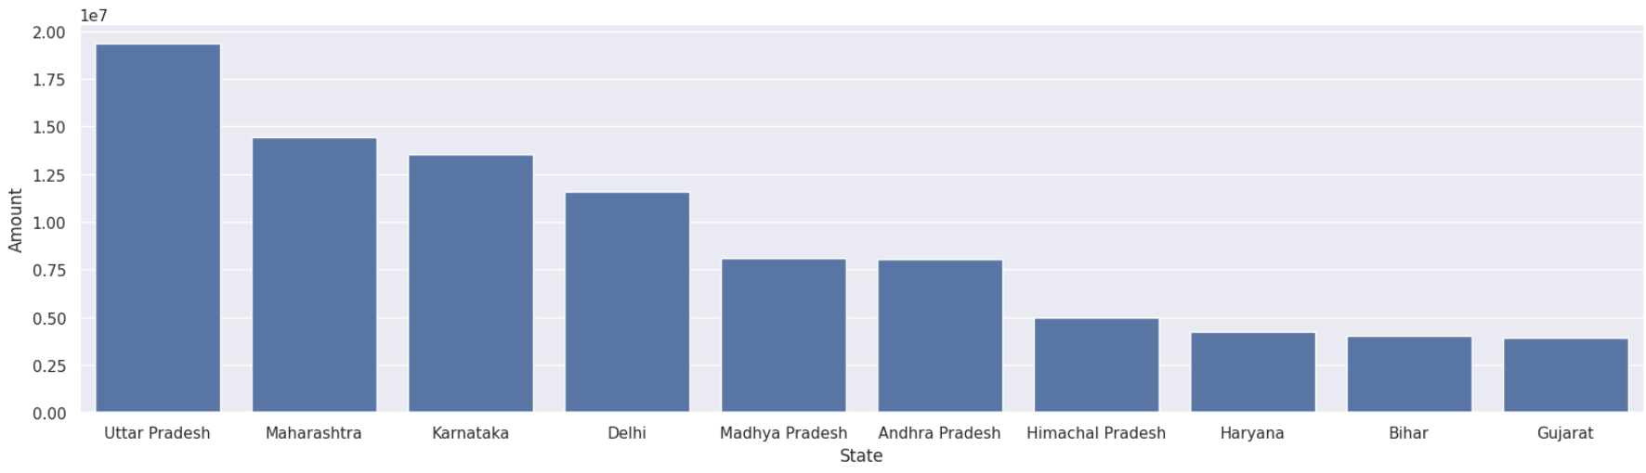
Q.5 Total number of purchasing by top 10 states with amount
Uttar Pradesh, Karnataka, and Maharashtra are the top states in terms of total sales revenue, demonstrating their significant contribution to overall sales.

Slide 10
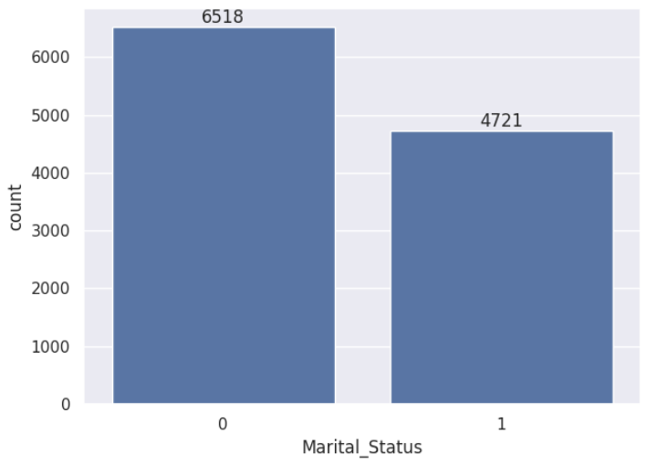
Q.6 Purchasing by Marital Status
Married women have higher purchasing power and contribute the most to sales, suggesting that they are a key target group for Diwali promotions.

Slide 11
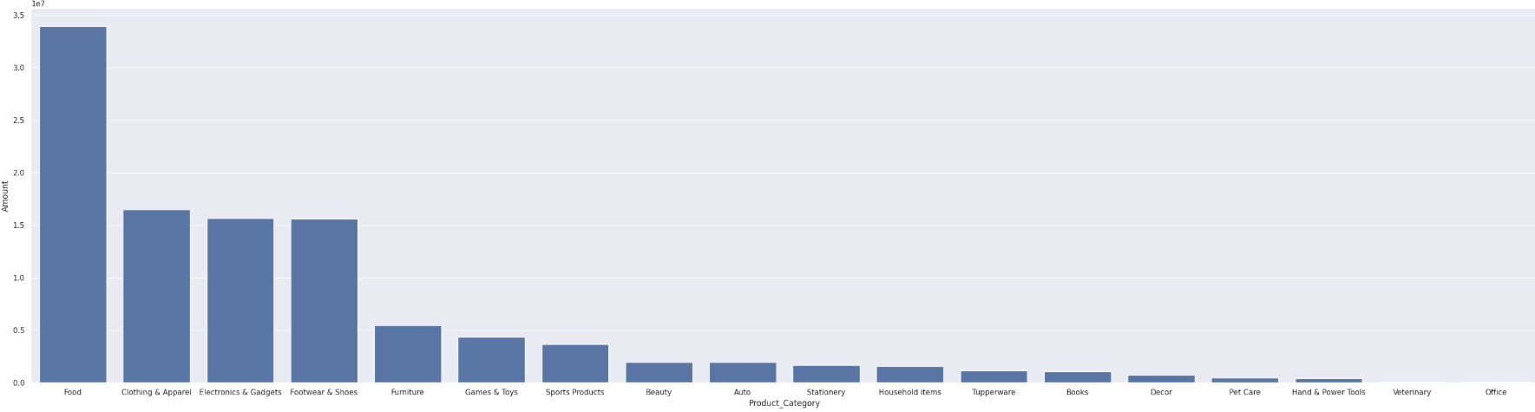
Q.7 Category of the purchasing product
Food, Clothing, and Electronics are the highest-selling product categories, indicating high demand for these items during Diwali.

Slide 12
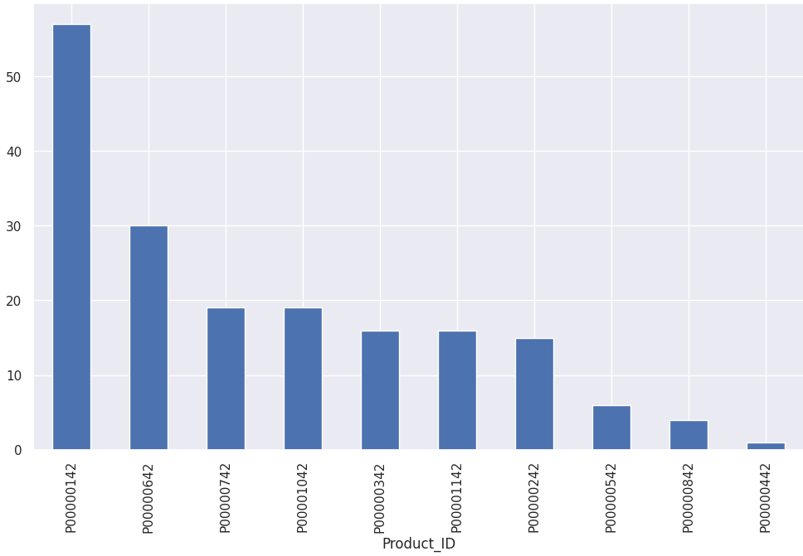
Q.8 Top 10 Sales purchase id
By identifying the top 10 selling product IDs, businesses can optimize inventory management and ensure the availability of these popular items to meet customer demand.

Slide 13
Conclusion
Target Audience: Married women aged 26-35, residing in Uttar Pradesh, Maharashtra, or Karnataka, employed in IT, Healthcare, and Aviation sectors, represent the most valuable customer segment.
Product Focus: Food, Clothing, and Electronics are the highest-selling product categories, indicating high demand and potential for increased sales.
Regional Opportunities: Uttar Pradesh, Maharashtra, and Karnataka are the top contributing states in terms of both order volume and sales revenue, suggesting significant market potential in these regions.
Strategic Implications: Businesses can leverage these insights to:
Develop targeted marketing campaigns to reach the most valuable customer segments with relevant offers and promotions.
Optimize inventory and supply chain management to ensure the availability of high-demand products in key regions.
Tailor product offerings and pricing strategies to meet customer preferences and maximize sales.
Enhance customer engagement and loyalty through personalized experiences and targeted communication.

Slide 14

THANK YOU

